Slide 1

David M. Kroenke and David J. Auer Database Processing: Fundamentals, Design, and Implementation
Chapter Seven (Selected)
SQL for Database Construction
and Application Processing

Slide 2
Database Available Online II
Online chapter 10B: Posted under “Oracle”

Slide 3
SQL Categories
SQL statements can be divided into five categories:
Data definition language (DDL)
Data manipulation language (DML) statements
SQL/Persistent Stored Modules (SQL/PSM) statements
Transaction control language (TCL) statements
Data control language (DCL) statements

Slide 4
SQL DDL
Data definition language (DDL) statements
Used for creating tables
Covered in this chapter (Chapter 7)

Slide 5
SQL DML
Data manipulation language (DML) statements
Used for:
Queries – SQL SELECT statement
Inserting data – SQL INSERT statement
Modifying data – SQL UPDATE statement
Deleting data – SQL DELETE statement
Covered in Chapter 2

Slide 6
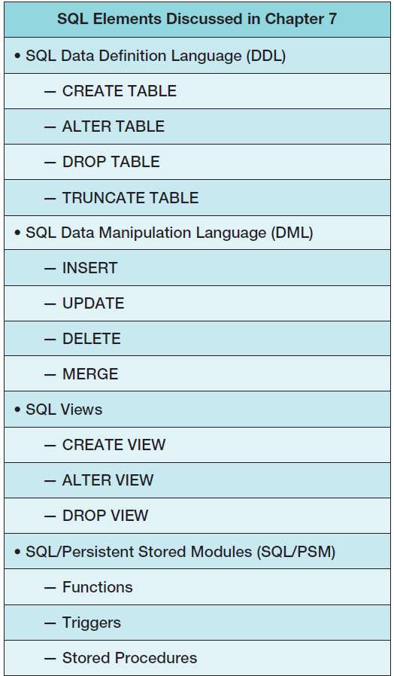
Chapter 7 SQL Elements

Slide 7
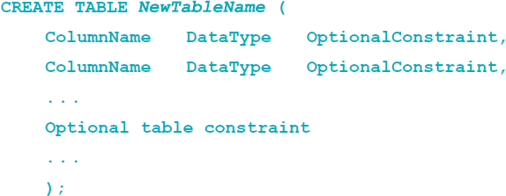
SQL CREATE TABLE Statement
CREATE TABLE statement is used for creating relations.
Each column is described with three parts: column name, data type, and optional constraints.
Format:

Slide 8
Column and Table Constraints
Constraints can be defined within the CREATE TABLE statement (or added after using ALTER table statement).
Column and table constraints include:
PRIMARY KEY ─ may not have NULL values
FOREIGN KEY ─ may or may not have NULL values
NULL / NOT NULL
UNIQUE
CHECK
The DEFAULT keyword (not a constraint)

Slide 9
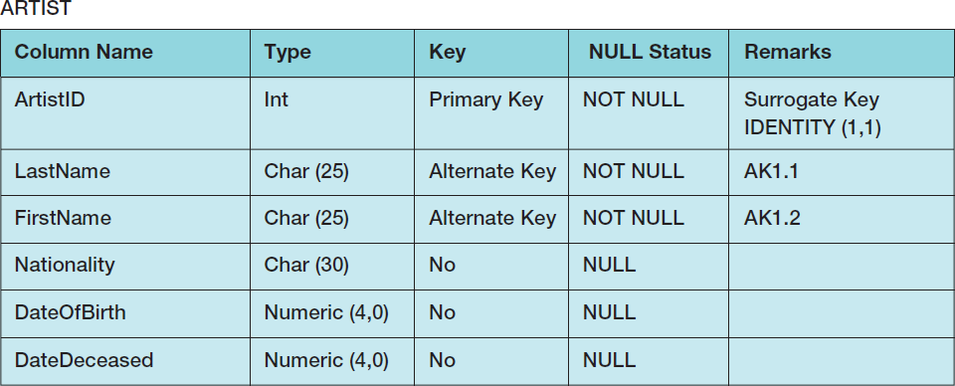
SQL CREATE TABLE Statement Example I
Column Characteristics:

Slide 10
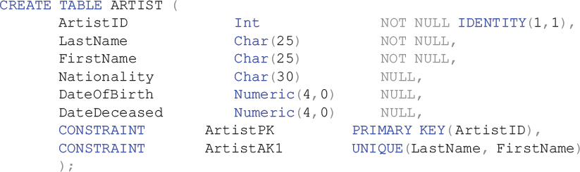
SQL CREATE TABLE Statement Example II
SQL CREATE TABLE statement:
Note: specific syntax for Oracle
varChar2

Slide 11
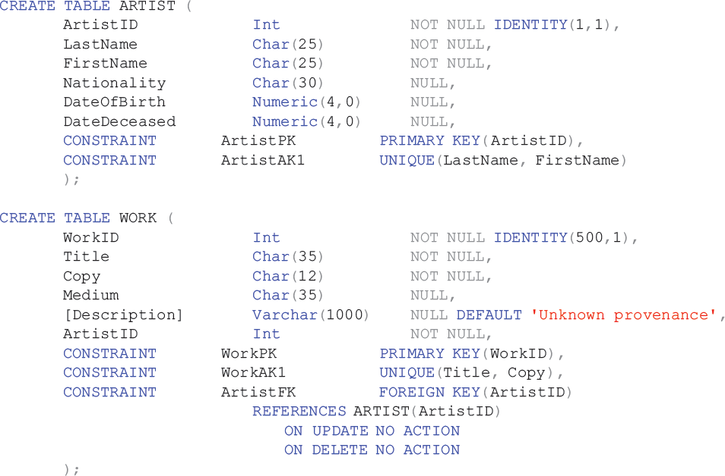

Creating Relations
Notes:
Note that you must define parent tables before child tables. In this case, you must define ARTIST before WORK. If you try to reverse the order of definition, the DBMS will generate an error message on the FOREIGN KEY constraint because it will not yet know about the ARTIST table.
Similarly, you must delete tables in the opposite order. You must DROP (described later in this chapter) a child before a parent. Better SQL parsers would sort out all of this so that statement order would not matter, but, alas, that’s not the way it’s done! Just remember the following: Parents are first in and last out.

Slide 12
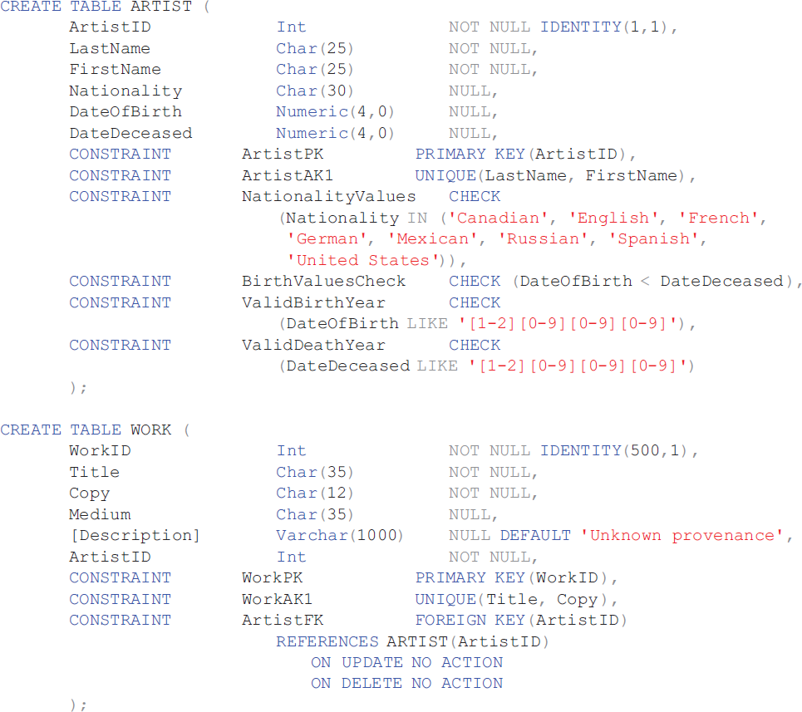
SQL for Constraints

Slide 13
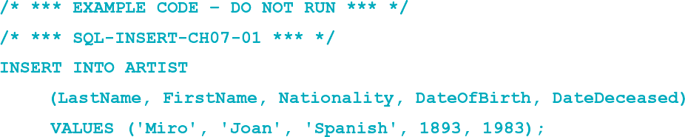
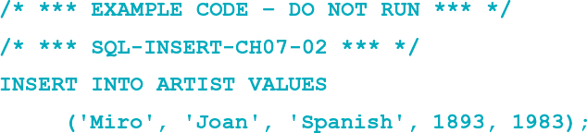
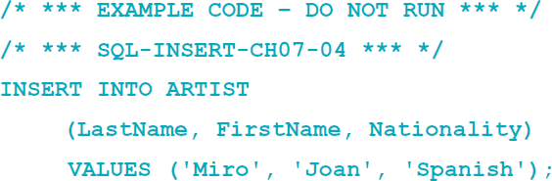
SQL DML—INSERT I
The SQL INSERT statement:

Slide 14
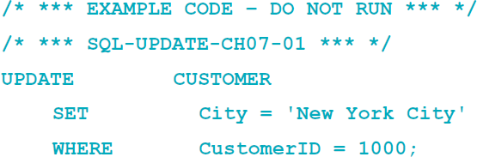
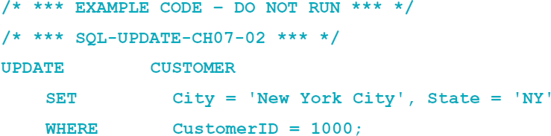
SQL DML—UPDATE I
The SQL UPDATE statement:
Notes:
The DBMS will enforce all referential integrity constraints when processing UPDATE commands.
For the VRG database, all keys are surrogate keys, but for tables with data keys, the DBMS will cascade or disallow (NO ACTION) updates according to the specification in the FOREIGN KEY constraint.
Also, if there is a FOREIGN KEY constraint, the DBMS will enforce the referential integrity constraint on updates to a foreign key.

Slide 15
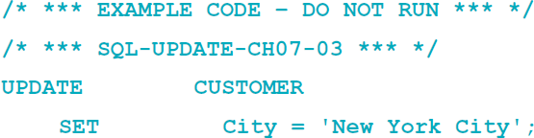
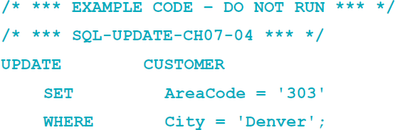
SQL DML—UPDATE II
Bulk UPDATE:

Slide 16
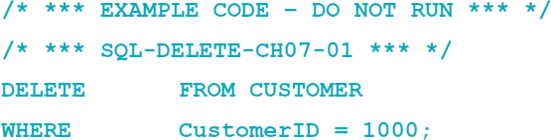
SQL DML—DELETE
SQL DELETE statement:
Note: If you omit the WHERE clause, you will delete every row in the table.

Slide 17
David Kroenke and David Auer Database Processing Fundamentals, Design, and Implementation (14th Edition)
End of Presentation:
Chapter Seven

Slide 18

All rights reserved. No part of this publication may be reproduced, stored in a retrieval system, or transmitted, in any form or by any means, electronic, mechanical, photocopying, recording, or otherwise, without the prior written permission of the publisher. Printed in the United States of America.

